Slide 1
Divide and Conquer

Slide 2
Objectives
Describe divide-and-conquer (D&C) approach for solving problems
Apply D&C approach for problems
Determine when D&C is an appropriate solution approach
Determine complexity analysis of D&C algorithms

Slide 3
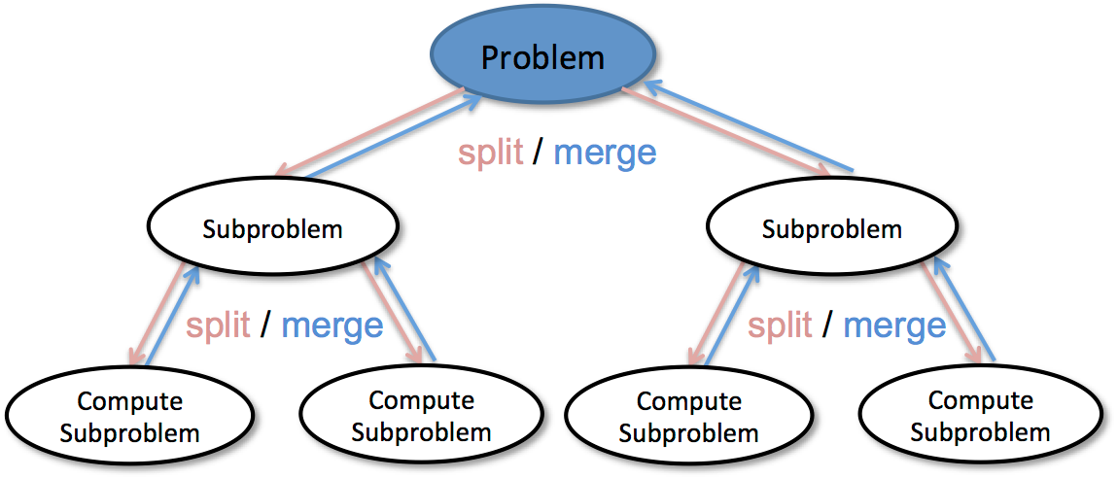
Introduction to D&C
D&C is a top-down approach where a problem is broken down into smaller subproblems, solved recursively, and then combined to obtain the final result.

Slide 4
D&C Steps
D&C has three main steps:
Divide
Dividing the problem to smaller instances of the same problem
Conquer
If the sub problem is small enough, then solve it
Combine
Combine the solutions to sub-problems to get the solution to the original problem

Slide 5
Recurrence and D&C
D&C algorithms generally result in recurrences in form:
T(n)= a.T(n/b) + f(n)
Where a≥1 and b>1
This function can characterize a D&C algorithm that:
Creates a sub-problems
Each sub-problem is of size 1/b
Divide and combine step together take f(n)
3 ways to deal with recurrences
Substitution (discussed before)
Recursion tree
Master method

Slide 6

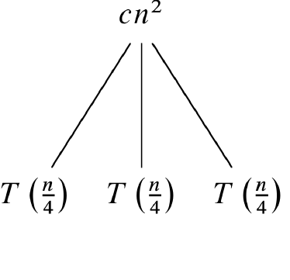
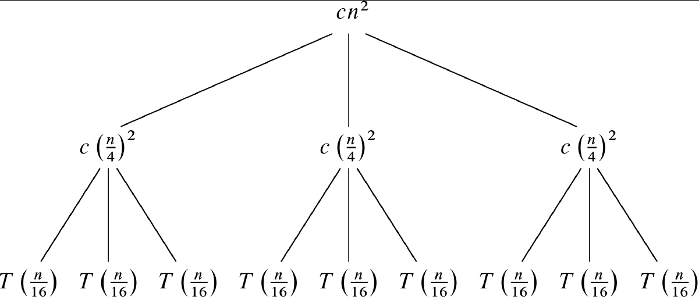
2. Recursion Tree
Example: T(n)=3T(n/4)+cn²

Slide 7
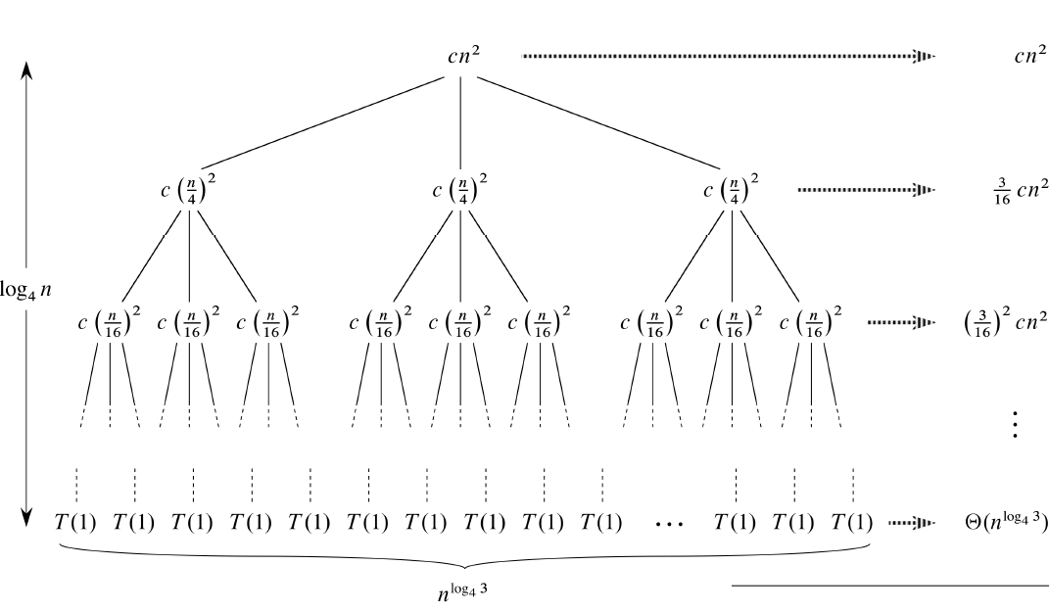

2. Recursion Tree (cont.)
What is the proof for O(n²)?

Slide 8
Steps to Calculate Time Complexity Using a Recursion Tree
Write the recurrence relation that represents the problem
Expand the recurrence step by step into a tree structure
Determine the depth of the tree
Determine the work done at each level
Sum up the work across all levels

Slide 9
Merge Sort
Sort an array S of size n (for simplicity, let n be a power of 2)
Divide Step
Divide the array into two sub-arrays of size n/2
Conquer:
Recursively sort each sub-array. When the sub-array is small enough, sort it.
Combine
Simple linear time algorithm for merging 2 sub-arrays

Slide 10
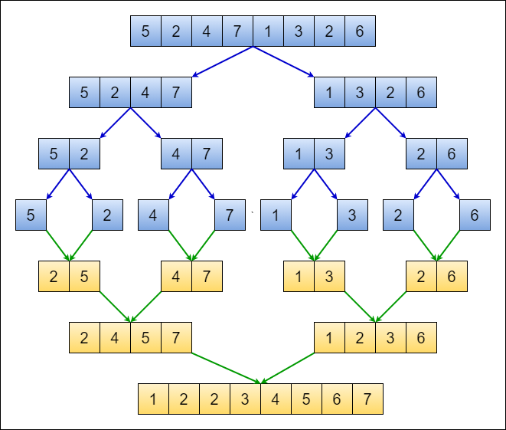
Merge Sort

Slide 11
Practice: Merge Sort Analysis
T(n)= 2T(n/2) + cn
2 sub-problems
cn: extra work to combine results
T(n) ϵ O(n.log(n))

Slide 12
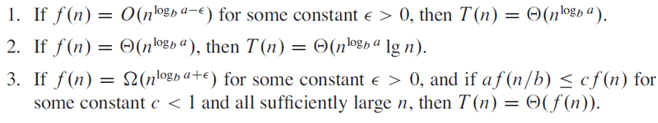
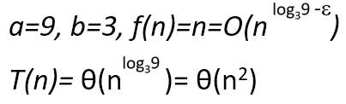
3. Master Method
To solve recurrence in form T(n)= aT(n/b)+f(n) the master method provides three cases (while a≥1 and b>1):
Example1: T(n)= 9T(n/3)+n

